Slide 1

Pratique orale LEA2
WEEK 2

Slide 2
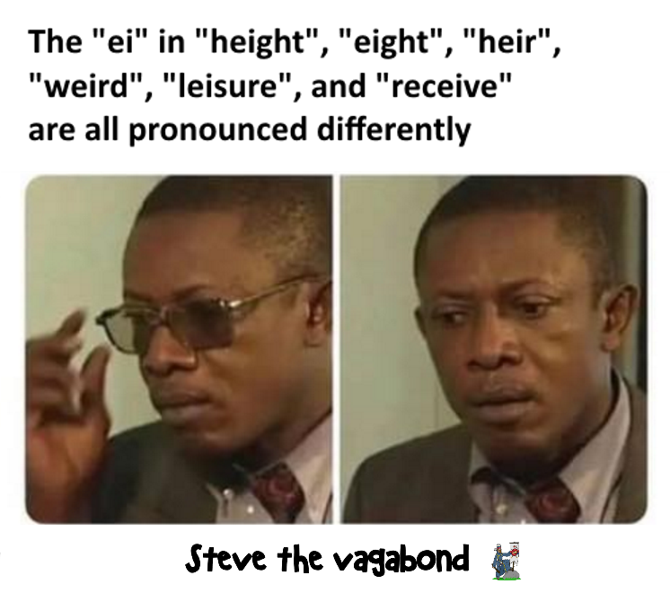
IPA – International Pronunciation Alphabet
« The Chaos »
Dearest creature in creation,
Study English pronunciation.
I will teach you in my verse
Sounds like corpse, corps, horse, and worse.
I will keep you, Suzy, busy,
Make your head with heat grow dizzy.
Tear in eye, your dress will tear.
So shall I! Oh hear my prayer.
Just compare heart, beard, and heard,
Dies and diet, lord and word,
Sword and sward, retain and Britain.
(Mind the latter, how it's written.)
Now I surely will not plague you
With such words as plaque and ague.
But be careful how you speak:
Say break and steak, but bleak and streak;
Cloven, oven, how and low,
Script, receipt, show, poem, and toe.
[…]

Slide 3
Règles élémentaires
Anglais : langue accentuelle → syllabes vs. accentuées réduites
Règles d’accentuation
Tous les mots lexicaux (noms, verbes, adjectifs, adverbes) ont au moins un accent lexical. Les mots grammaticaux sont souvent réduits.
Les syllabes inaccentuées sont la plupart du temps réduites : /ə/. A l’oral, il faut bien marquer la différence entre les syllabes accentuées et les syllabes inaccentuées.
Intonation de l’anglais: descendante dans les phrases déclaratives ainsi que dans les questions ouvertes (Wh-) (et montante pour les questions fermées (« yes/no questions ») )

Slide 4
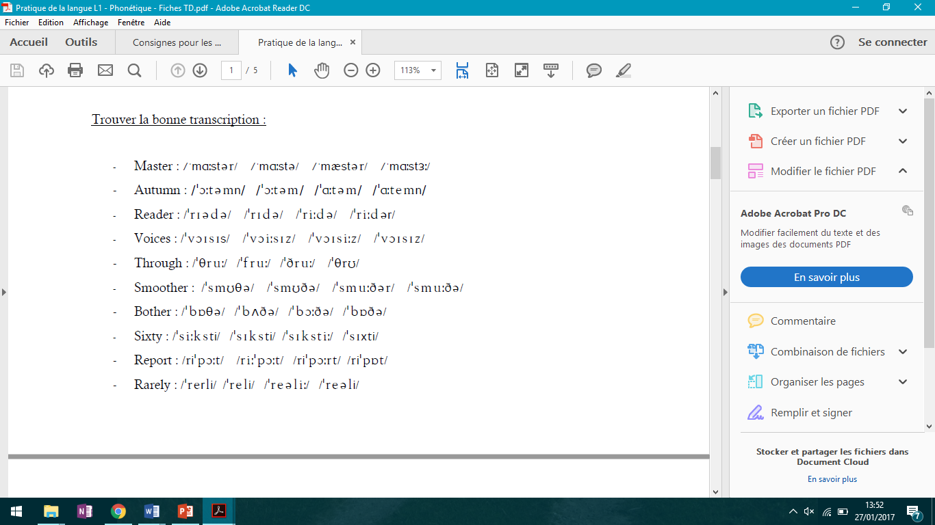
Exercices de familiarisation

Slide 5
Exercices de familiarisation
/ˈmɑːstə/ (BE) /ˈmæstər/ (US)
/ˈɔːtəm/ /ˈɑːt̬əm/
/ˈriːdə/ /ˈri(ː)dər/
/ˈvɔɪsiz/
/ˈθruː/
/ˈsmuːðə/ /ˈsmu(ː)ðər/
/ˈbɒðə/ /ˈbɑːðər/
/ˈsɪksti/

Slide 6
Transcrire les mots suivant en alphabet latin :
/ˈməʊst/
/əˈlaʊ/
/ˈlɔː/
/bɪˈləʊ/
/ˈnaɪs/
/ˈdʌbəl/
/ˈɑːsk/

Slide 7
Transcrire les mots suivant en alphabet latin :
/ˈməʊst/
/əˈlaʊ/
/ˈlɔː/
/bɪˈləʊ/
/ˈnaɪs/
/ˈdʌbəl/
/ˈɑːsk/
→ Most
→ Allow
→ Law
→ Below
→ Nice
→Double
→ Ask

Slide 8
Transcrire les mots suivant en IPA :
Eight
Point
Debt
Weight
One
Student
Health
Crisis

Slide 9
Transcrire les mots suivant en IPA :
Eight
Point
Debt
Weight
One
Student
Health
Crisis
→/ˈeɪt/
→/ˈpɔɪnt/
→/ˈdet/
→/ˈweɪt/
→/ˈwʌn/
→/ˈstuːdənt/
→/ˈhelθ/
→/ˈkraɪsɪs/

Slide 10
Introducing the news
Introduction:
Type of document
Key words
Wh- questions

Slide 11
Read those definitions and match them to the different types of documents.
News report – Interview – Obituary – Speech
1. A report, especially in a newspaper, that gives the news of someone's death and details about their life and their life’s work
2. A formal talk given usually to a large number of people on a special occasion
3. A description of an event or situation that has happened in the news recently
4. A conversation between a journalist or radio or television anchorman/woman and a person of public interest, used as the basis of a broadcast or publication.

Slide 12
Read those definitions and match them to the different types of documents.
News report – Interview – Obituary – Speech
1. A report, especially in a newspaper, that gives the news of someone's death and details about their life and their life’s work
2. A formal talk given usually to a large number of people on a special occasion
3. A description of an event or situation that has happened in the news recently
4. A conversation between a journalist or radio or television anchorman/woman and a person of public interest, used as the basis of a broadcast or publication.
Obituary
Speech
News report
Interview

Slide 13
Extract 1 : type of document (e.g. news report, interview, obituary, speech)
What is it about?
Who?
When?
Where?
Extract 2 :
Extract 3 :
Extract 4 :

Slide 14
Extract 1 : “Charlie Watts, Unshakeable Rolling Stones Drummer, Dies At 80”
Extract 2 : “Finish the Fight paints a different pictures of women who pushed for a vote”
Extract 3 : “What To Know About The Spying Scandal Linked To Israeli Tech Firm NSO”
Extract 4 : “Kamala Harris’s first speech as Vice President elect”
obituary
interview
news report
speech

Slide 15
Extract 1 : “Charlie Watts, Unshakeable Rolling Stones Drummer, Dies At 80”
This document is an obituary about Charlie Watts, musician in the Rolling Stones band, who died at 80. Andrew Limbong comes back on his life and the kind of musician he was in the band.
Extract 2 : “Finish the Fight paints a different pictures of women who pushed for a vote”
This document is an interview of writer Veronica Chambers who is invited to talk about the picture book she published Finish the Fight, in which she depicts the suffrage movement in a different light and tries to set records straight.
Extract 3 : “What To Know About The Spying Scandal Linked To Israeli Tech Firm NSO”
This document is a news report about the scandal shaking the Israeli cyber security company NSO group. Its software is said to be used by governments around the world to spy on sensitive targets, such as activists, journalists, or other government heads.
Extract 4 : “Kamala Harris’s first speech as Vice President elect”
This document is an excerpt from the first speech Kamala Harris made as Vice President elect. She reflets on what this presidential victory means for democracy. Quoting John Lewis, she insists on the responsibility of every citizen to defend it.
obituary
interview
news report
speech

